Slide 1



Slide 2

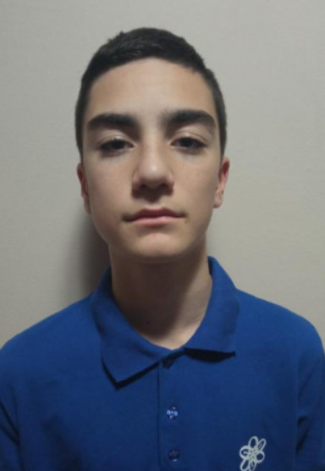
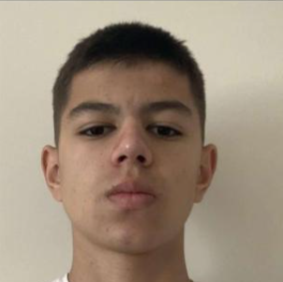
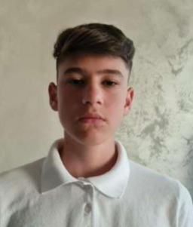
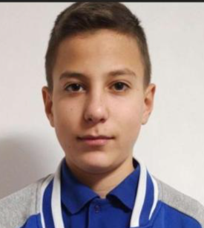
Our team:
Radomir Aleksandrov
9А
Scrum Trainer
Stanimir
Popov
9В
QA Engineer
Enis
Mustafa
9V
Back-end Developer
Stilian
Georgiev
9G
Front-end Developer

Slide 3
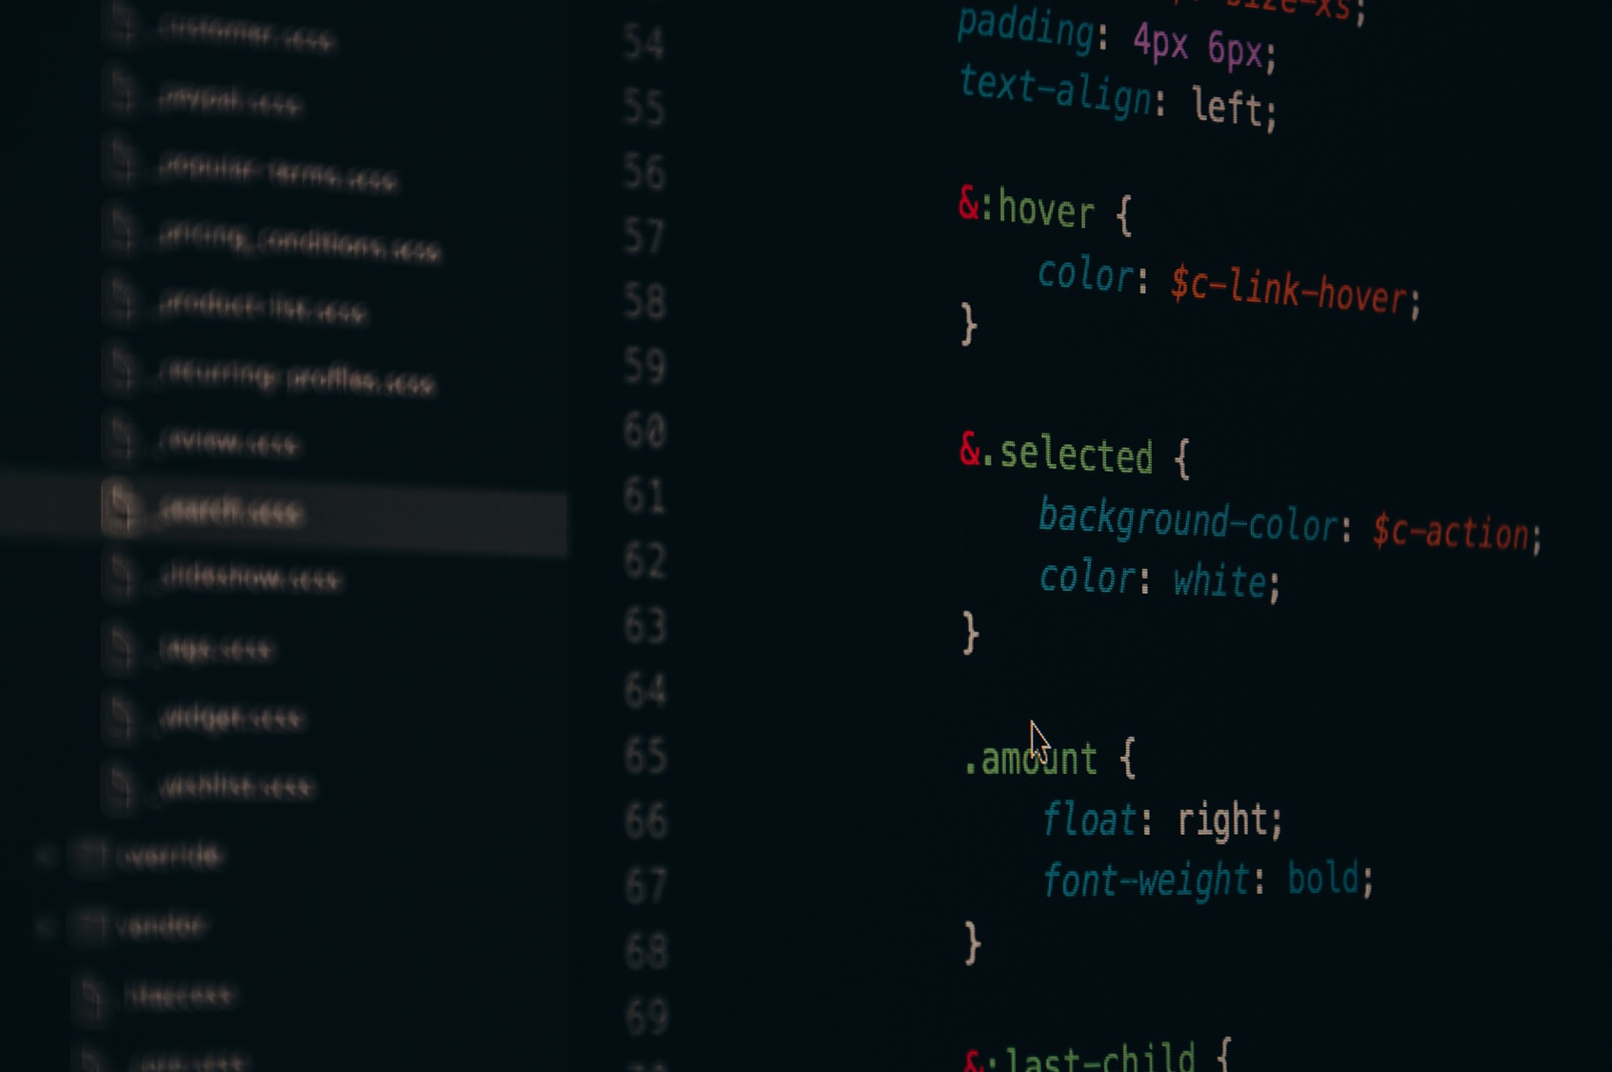
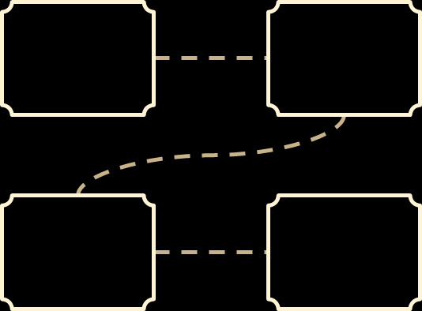
Our steps at work
Idea.
Team.
Idea and explanation.
01
02
Distribution of duties.​
Realization.​
Used Technologies.​
03
04
Ways of implementation.
Choice of technologies.​

Slide 4

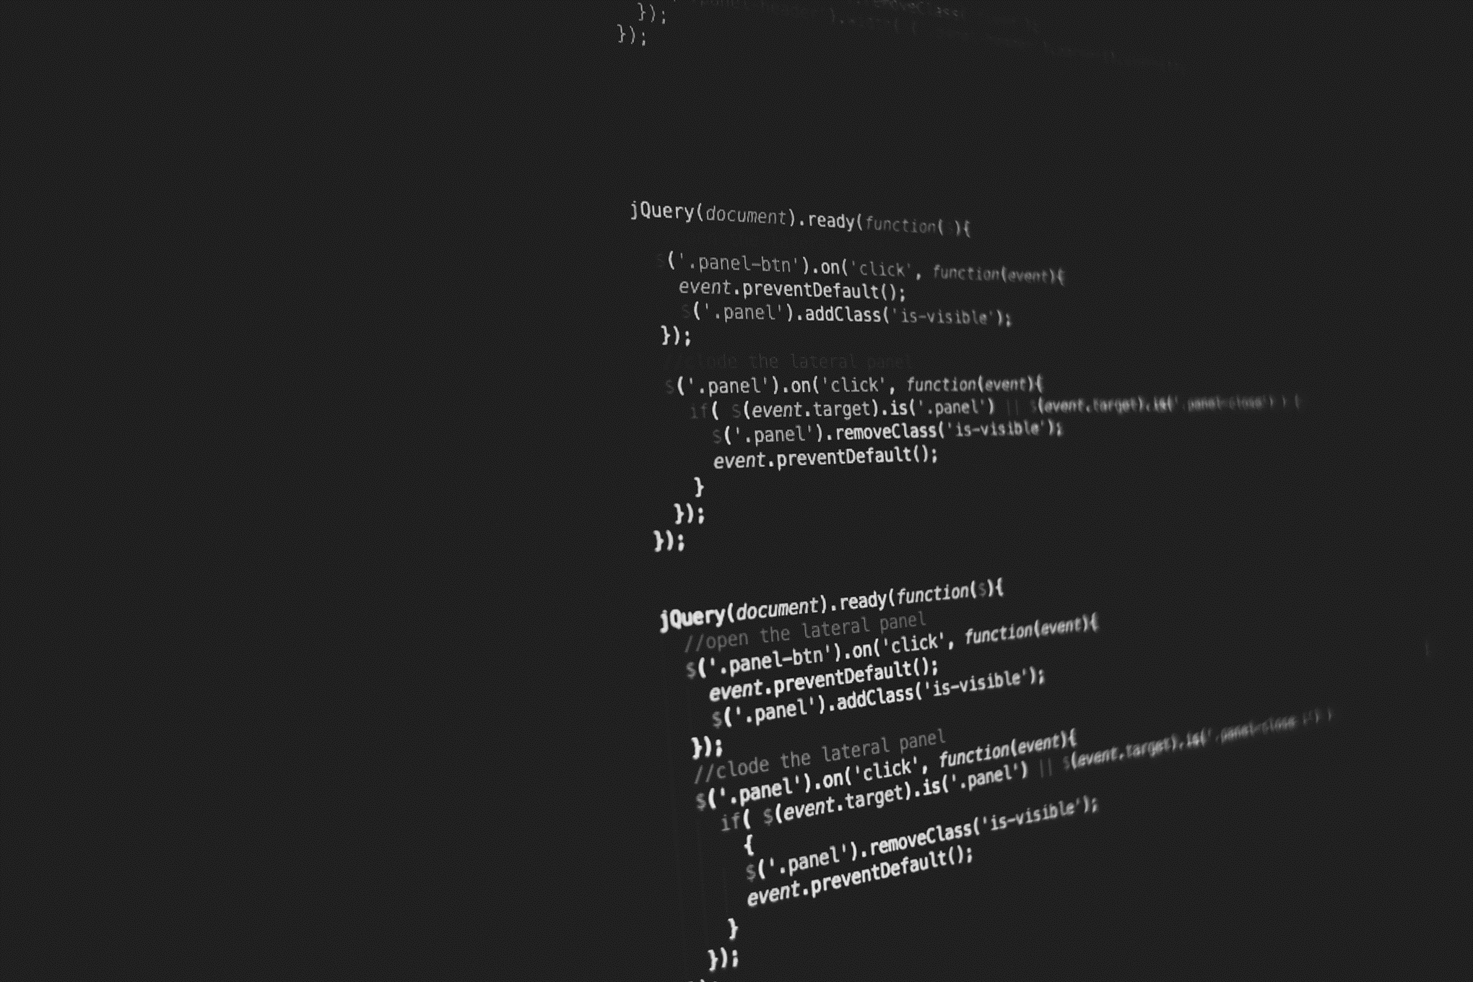




THE IDEA
- The idea is to guess the word
- It's all in your hands to save the hero

Slide 5
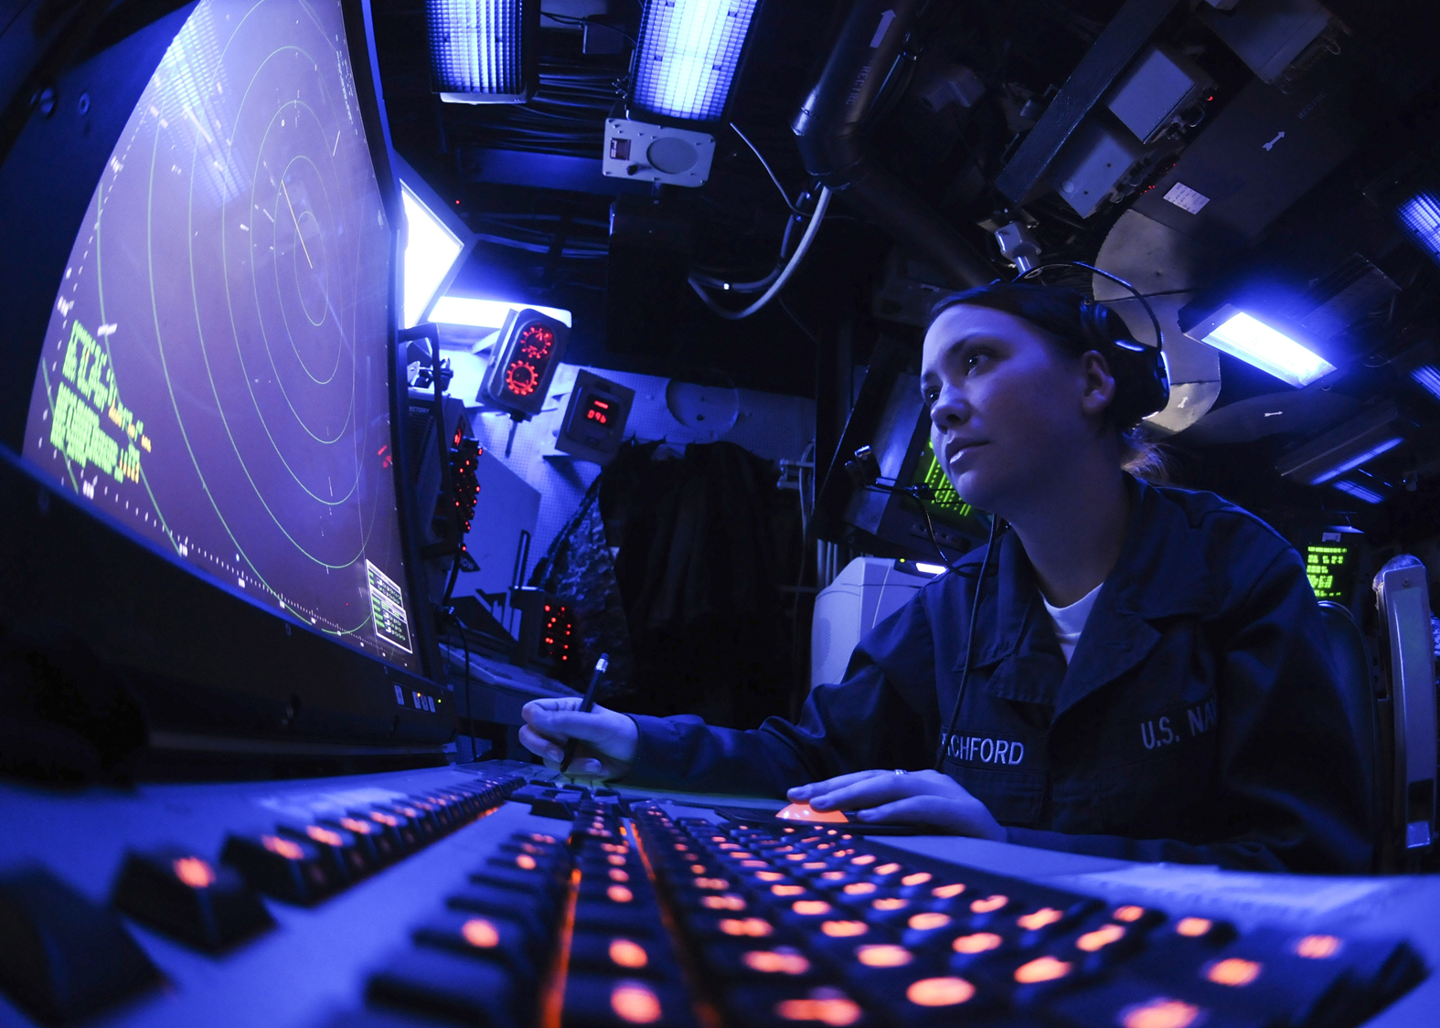






What did we use?

Slide 6

Now let's see the Repo.

